Slide 1
Introduction to Generalized Linear Models (GLM)
Jaehyoung Hong

Slide 2
Outline
1. Definition of generalized linear model (GLM)
- Three components
2. GLM for binary response
- Logistic regression
3. GLM for counts and rates
- Poisson GLM and negative binomial GLM
4. Likelihood equations and covariance matrix of ML parameter estimates
5. Inference and model checking for GLM
6. Fitting GLM
7. Quasi-likelihood and GLM

Slide 3


Three components of GLM : Random and systemic component and link function
1. Random component : Response variable Y and its probability distribution
2. Systemic component : Explanatory variables
3. Link function : Function of $E(Y)$ that the model equates to the linear predictor
$\left(y_{1},…y_{N}\right)$: Independent observations from natural exponential family
<Pdf of Natural exponential family>
$\left(η_{1},…,η_{N}\right)$ : Linear predictor → Linear combination of explanatory variables
$x_{ij}$ : Value of explanatory variable $j (j=0,1,2,…)$ for subject $i$

Slide 4
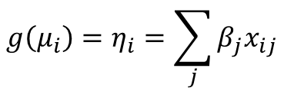

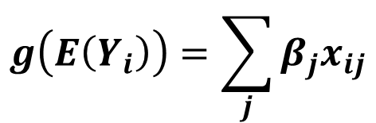
Three components of GLM : Random and systemic component and link function
1. Random component : Response variable Y and its probability distribution
2. Systemic component : Explanatory variables
3. Link function : Function of $E(Y)$ that the model equates to the linear predictor
$\left(y_{1},…y_{N}\right)$: Independent observations from natural exponential family
<Pdf of Natural exponential family>
Let $μ_{i}=E(Y_{i})$ for $i = 1,…,N$
$$g\left(μ_{i}\right)=η_{i}=\sum_{j}{β_{j}x_{ij}}$$
$$g\left(E\left(Y_{i}\right)\right)=\sum_{j}{β_{j}x_{ij}}$$
Link function $g$ is monotonic, differentiable
<GLM>
If $g\left(μ_{i}\right)=Q\left(θ_{i}\right),$ then we call $g$ : canonical link

Slide 5
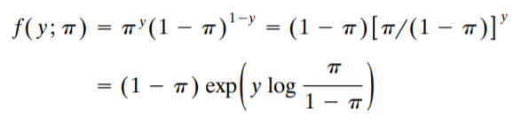


Example : Binary logit models for binary data
<$Logit models$>
$$→θ=π , a\left(π\right)=1−π, b\left(y\right)=1, Q\left(π\right)=log⁡[\frac{π}{1−π}]$$
$E\left(Y\right)=π→g\left(μ\right)=Q(π)$ : Canonical link
$Logistic Regression models$ or $Logit model$

Slide 6





Example2 : Poisson loglinear models for count data
<$Poisson loglinear models$>
$$→θ=μ , a\left(μ\right)=exp⁡(−μ), b\left(y\right)=1/y!, Q\left(μ\right)=log(μ)$$
$E\left(Y\right)=μ→g\left(μ\right)=Q(μ)$ : Canonical link
$$Poisson loglinear model$$

Slide 7
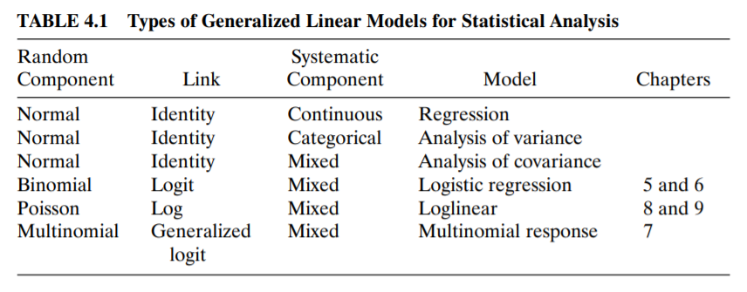
Type of GLM for statistical analysis

Slide 8







Linear probability model : GLM to binary data
$$Y :Binary response$$
$$E\left(Y\right)=P\left(Y=1\right)=π(x)$$
$$var\left(Y\right)=π\left(x\right)[1−π\left(x\right)]$$
$x=(x_{1},…,x_{p})$ : Explanatory variables
<$Linear probability model$>
Can you find problem?
$$π\left(x\right)=α+β_{1}x_{1}+…+β_{p}x_{p}$$
($π\left(x\right)>1 or π\left(x\right)<0$ is possible)

Slide 9
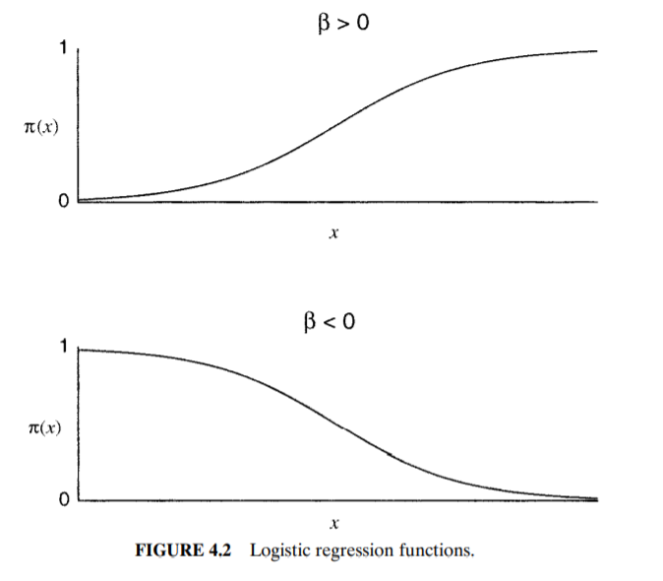
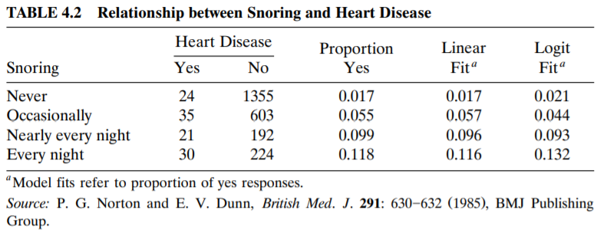








Example : Snoring and heart disease
<$Logistic fit$>
<$Linear fit$>
$$π\left(x\right)=\frac{exp⁡(α+βx)}{1+exp⁡(α+βx)}$$
Use scores (0, 2, 4, 5) for snoring
($π\left(x\right)∈\left[0,1\right]$)
$$\hat{π}\left(x\right)=0.0172+0.0198x$$
$$\log{\frac{π\left(x\right)}{1−π\left(x\right)}}=α+β_{1}x_{1}+…+β_{p}x_{p}$$
(with $\hat{β}=0.0198$ having $SE=0.0028$)
$$logit\left[\hat{π}\left(x\right)\right]=−3.87+0.40x$$

Slide 10









Example : Probit and invers cdf Link functions
<$Probit model$>
$Φ(⋅)$ : standard cdf of the class
$$π\left(x\right)=Φ(α+βx)$$
$$Φ^{−1}[π\left(x\right)]=α+βx$$
<$Logistic distribution$>
$$π\left(x\right)=\frac{exp⁡(α+βx)}{1+exp⁡(α+βx)}$$
($β>0$)
$$Φ\left(x\right)=\frac{exp⁡[{(x−μ)}/τ]}{1+exp⁡[{(x−μ)}/τ]}$$
Cdf
(mean$μ$ & dispersion $τ>0$)

Slide 11








Example : Latent tolerance motivation for binary response models
<$Latent tolerance motivation$>
$$x :Dosage level$$
$$Y=1 :Death$$
$$Y=1 ⇔T≤x$$
$$T:threshold$$
Let $F\left(t\right)=P(T≤t)$
$$π\left(x\right)=P\left(Y=1 | X=x\right)=P\left(T≤x\right)=F(x)$$
$$π\left(x\right)=F\left(x\right)=Φ[\frac{x−μ}{σ}]$$
$$Φ^{−1}\left[π\left(x\right)\right]=α+βx$$

Slide 12
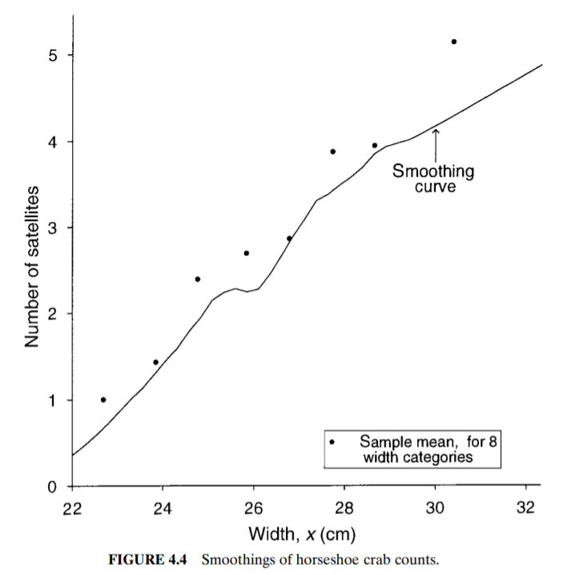
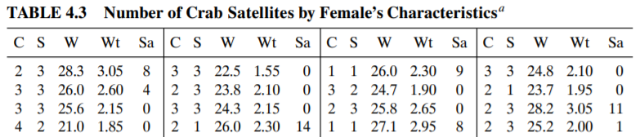



Poisson Loglinear Models
<$Poisson loglinear models$>
$$\log{μ\left(x\right)}=α+β_{1}x_{1}+⋯+β_{p}x_{p}$$
$$μ\left(x\right)=\exp\left(α{+β}_{1}x_{1}+⋯+β_{p}x_{p}\right)=e^{α}{\left(e^{β_{1}}\right)}^{x_{1}}⋯{\left(e^{β_{p}}\right)}^{x_{p}}$$

Slide 13
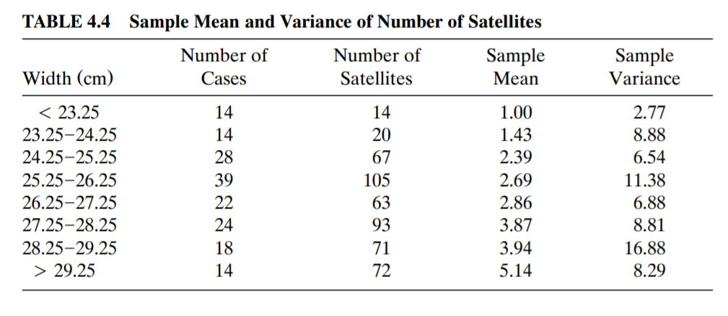



Overdispersion for Poisson GLMs
<$Overdispersion$>
$$Poisson :E=Var$$
If true distribution is not poisson, usually variance is larger than mean
1) Extension of Poisson GLM having extra parameter
2) Quasi-likelihood inference ($Var=φμ$)

Slide 14
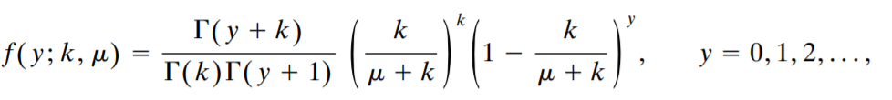




Negative binomial GLMs
<$Negative binomial GLMs$>
$$k>0, μ>0$$
$$E\left(Y\right)=μ, Var\left(Y\right)=μ+γμ^{2}$$
$$( γ=\frac{1}{k} )$$
Exponential family (if $γ$ is fixed) + Converge to poisson when $γ→0$
$$Poisson : \hat{μ}=−11.53+0.55x (SE=0.06 for \hat{β})$$
vs
NB GLM can capture overdispersion
$$NB : \hat{μ}=−11.47+0.55x (SE=0.12 for \hat{β})$$
$$(\hat{γ}=1.07→var\left(Y\right)=\hat{μ}+{\hat{μ}}^{2} :Geometric distribution)$$

Slide 15



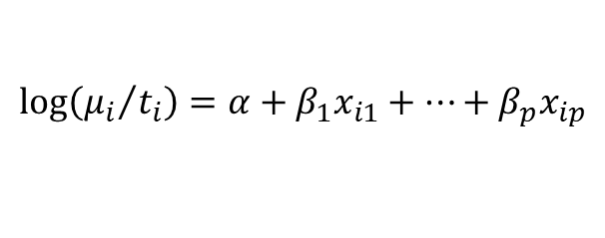
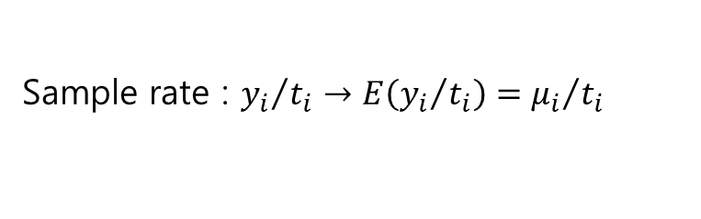
Poisson regression for rates using offsets
<$GLM for rates$>
$Y_{i} :count$has and index $t_{i}$ such that its expected value is proportional to $t_{i}$
Sample rate : ${y_{i}}/{t_{i}}→E\left({y_{i}}/{t_{i}}\right)={μ_{i}}/{t_{i}}$
$$\log\left({μ_{i}}/{t_{i}}\right)=α+β_{1}x_{i1}+⋯+β_{p}x_{ip}$$
$$\log\left(μ_{i}\right)−log(t_{i})=α+β_{1}x_{i1}+⋯+β_{p}x_{ip}$$
$$offset$$
$$μ_{i}=t_{i}exp⁡(α+β_{1}x_{i1}+⋯+β_{p}x_{ip})$$

Slide 16
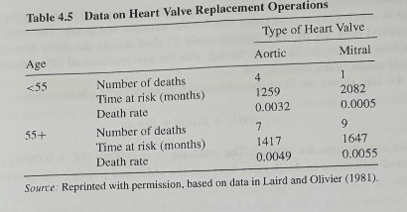


Example : $GLM for rates$
<$GLM for rates$>
$$\log\left({μ_{ij}}/{t_{ij}}\right)=α+β_{1}a_{i}+β_{2}v_{j}, where a_{i} :age indicator \& v_{j} :valve type indicator$$
$$\hat{β_{1}}=1.221 \left(SE=0.514\right), \hat{β_{2}}=−0.330 (SE=0.438)$$

Slide 17





Exponential dispersion family
<$Exponential dispersion family$>
$$φ :dispersion parameter, θ :natural parameter$$
$$φ is known$$
<$Natural exponential family>$
$$Q\left(θ\right)=\frac{θ}{a\left(φ\right)}, a\left(θ\right)=\exp\left[−\frac{b\left(θ\right)}{a\left(φ\right)}\right], b\left(y\right)=exp⁡[c\left(y,φ\right)]$$
Usually $a\left(φ\right)=φ/w_{i}$ for some known weight $w_{i}$

Slide 18


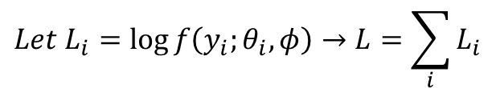
Mean & variance for random component
<$Mean \& variance$>
What to do?
Express $E\left(Y_{i}\right) \& Var(Y_{i})$ with above component
$$Let L_{i}=\log{f\left(y_{i};θ_{i},φ\right)}→L=\sum_{i}{L_{i}}$$

Slide 19
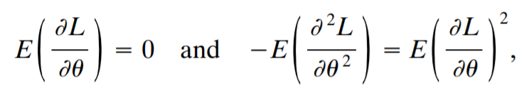



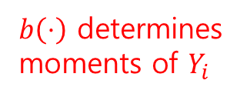
Mean & variance for random component
<$Mean \& variance$>
What to do?
Express $E\left(Y_{i}\right) \& Var(Y_{i})$ with above component
$b\left(⋅\right)$ determines
moments of $Y_{i}$
(cumulant function)

Slide 20
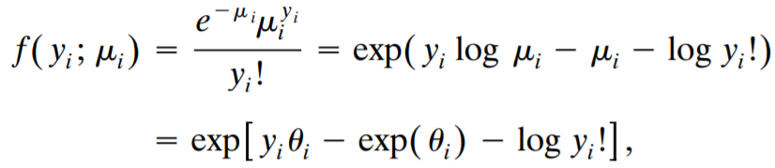
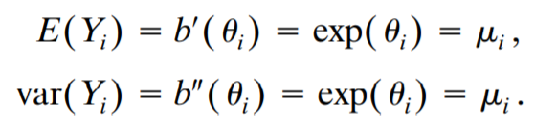


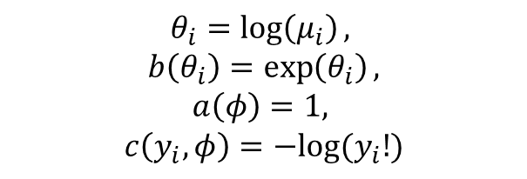
Mean & variance for Poisson and binomial
<$Mean \& variance for poisson \& binomial$>
$$1. Y_{i} is poisson$$
<$Exponential dispersion family$>
$$θ_{i}=\log\left(μ_{i}\right),$$
$$b\left(θ_{i}\right)=\exp\left(θ_{i}\right),$$
$$a\left(φ\right)=1,$$
$$c\left(y_{i},φ\right)=−log⁡(y_{i}!)$$

Slide 21
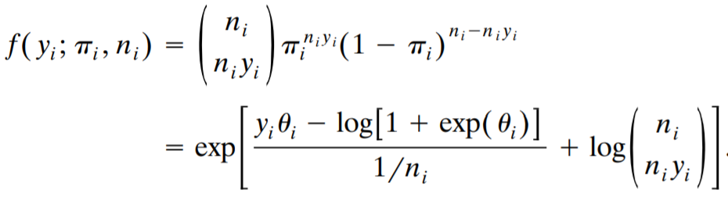
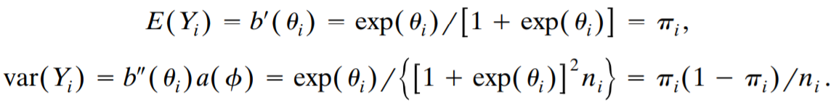

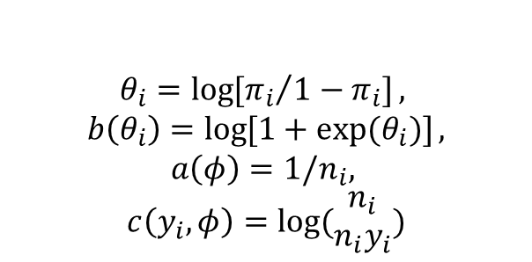
Mean & variance for Poisson and binomial
<$Mean \& variance for poisson \& binomial$>
$2. {n_{i}Y}_{i} is bin(n_{i},π_{i})$ : $y_{i}$ is sample proportion (rather than number) of success
<$Exponential dispersion family$>
$$θ_{i}=\log{[{π_{i}}/{1−π_{i}}]},$$
$$b\left(θ_{i}\right)=\log{[1+exp⁡(θ_{i})]},$$
$$a\left(φ\right)=1/n_{i},$$
$$c\left(y_{i},φ\right)=log⁡(\begin{matrix}n_{i} \\ n_{i}y_{i}\end{matrix})$$

Slide 22
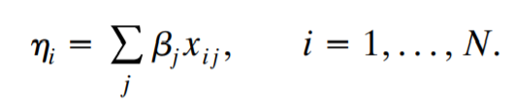

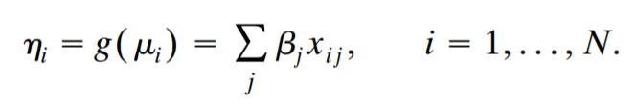

Systemic component and link function
<$\text{Systemic} \text{component} \text{and} \text{link} \text{function}$>
Recall
$X$: Model matrix (in GLM)

Slide 23
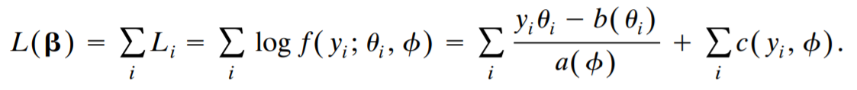
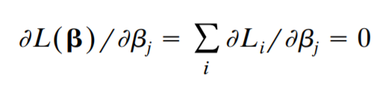
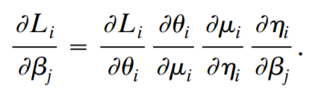


Likelihood equations for a GLM
<$Likelihood equation$>
$$For N independent equations$$
The notation of $L\left(β\right)$ reflects the dependence of $θ$ on the model parameters $β$
$$for all j$$

Slide 24

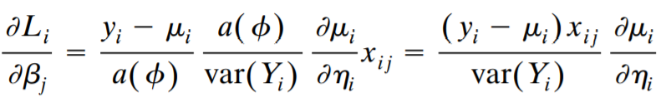
Likelihood equations for a GLM
<$Likelihood equation$>

Slide 25
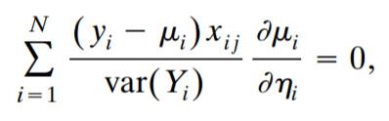
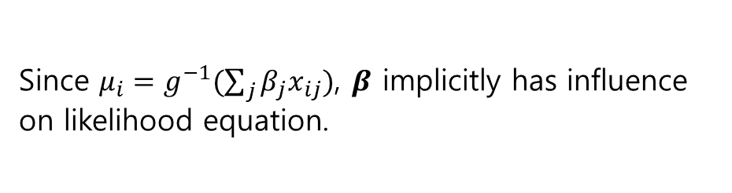

Likelihood equations for a GLM
<$Likelihood equation$>
$$j=0, 1, 2,⋯$$
Note
Since $μ_{i}=g^{−1}(\sum_{j}{β_{j}x_{ij}})$, $β$ implicitly has influence on likelihood equation.

Slide 26
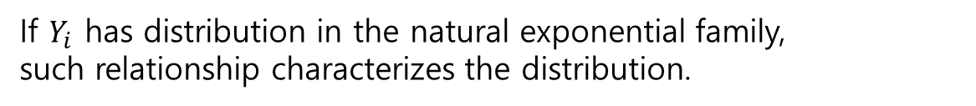

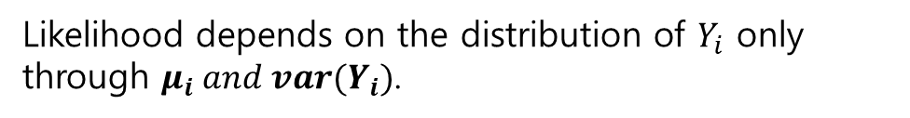

The key role of the mean-variance relationship
<$Mean−variance relationship$>
$$j=0, 1, 2,⋯$$
Likelihood depends on the distribution of $Y_{i}$ only through $μ_{i} and var(Y_{i})$.
Variance itself depends on the mean
$$var\left(Y_{i}\right)=ν(μ_{i})$$
If $Y_{i}$ has distribution in the natural exponential family,
such relationship characterizes the distribution.
$e.g. ν\left(μ_{i}\right)=μ_{i}$ then necessarily $Y_{i}$ has the Poisson.

Slide 27
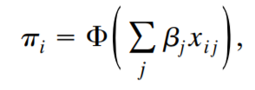
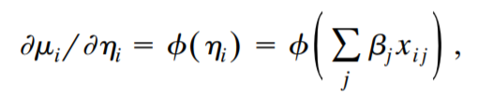
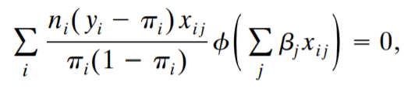
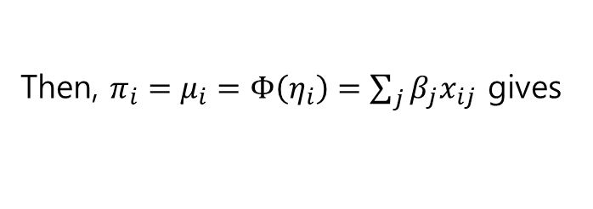



Example : Likelihood equations for Binomial GLMs
<$Likelihood eq for bin(n_{i},π_{i})$>
$$j=0, 1, 2,⋯$$
Recall,
Then, $π_{i}=μ_{i}=Φ\left(η_{i}\right)=\sum_{j}{β_{j}x_{ij}}$ gives
$$φ\left(u\right)=dΦ(u)/du$$
since $var\left(Y_{i}\right)=π_{i}(1−π_{i})/n_{i}$

Slide 28

Example : Likelihood equations for Binomial GLMs
<$Likelihood eq for bin(n_{i},π_{i})$>
When $Φ :standard logistic cdf$ & $η_{i}=log⁡[\frac{π_{i}}{1−π_{i}}]$

Slide 29
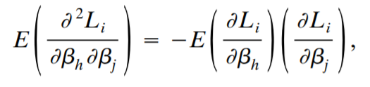
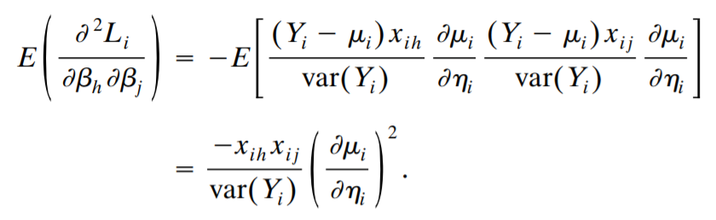
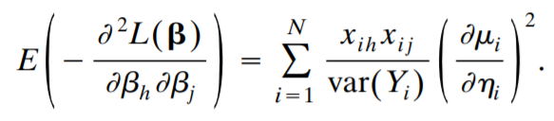


Asymptotic Covariance matrix
<$Covariance matrix of the \hat{β}$>
Recall,
$$J_{hj}=E[−\frac{∂^{2}L\left(β\right)}{∂β_{h}∂β_{j}}]$$
$$cov\left(\hat{β}\right)=J^{−1}$$
Fact
holds for exponential families

Slide 30


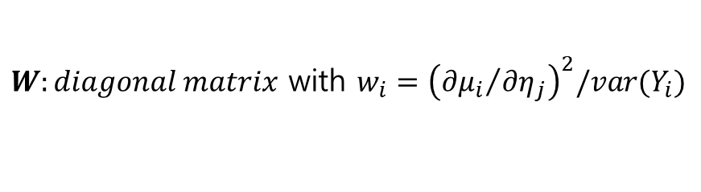
Asymptotic Covariance matrix
<$Covariance matrix of the \hat{β}$>
$W:diagonal matrix$ with $w_{i}={\left({∂μ_{i}}/{∂η_{j}}\right)}^{2}/var(Y_{i})$
$$J=X^{T}WX$$
$$\hat{cov}\left(\hat{β}\right)={\hat{J}}^{−1}={\left(X^{T}\hat{W}X\right)}^{−1}$$

Slide 31



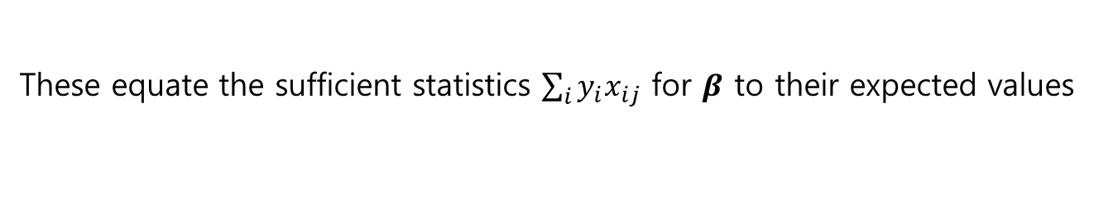


Example : $\hat{cov}\left(\hat{β}\right)$ for Poisson loglinear model
<$\hat{cov}\left(\hat{β}\right)$ for poisson loglinear>
For the log link, $η_{i}=\log\left(μ_{i}\right)$ & $var\left(Y_{i}\right)=μ_{i}$
These equate the sufficient statistics $\sum_{i}{y_{i}x_{ij}}$ for $β$ to their expected values
$\hat{cov}\left(\hat{β}\right)={\left(X^{T}\hat{W}X\right)}^{−1}$ with $\hat{W} :diagonal matrix$ with elements of $\hat{μ}$ on the main diagonal

Slide 32
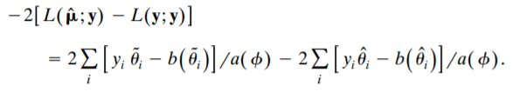
Deviance and Goodness of fit
<$Deviance and Goodness of fit$>
Consider all possible model
$L(μ;y)$ has its maximum $L(y;y)$ : Separate parameter for each observation → Saturate
Let $\tilde{θ}$ denote the estimate of $θ$ for the saturated model, corresponding to estimates means $\tilde{μ_{i}}=y_{i}$ for all $i$

Slide 33




Deviance and Goodness of fit
<$Deviance and Goodness of fit$>
$$a\left(φ\right)=φ/w_{i}$$
We call it, $scaled deviance$
Greater scaled deviance, the poorer the fit
$$D\left(y;\hat{μ}\right) :Deviance$$

Slide 34






Example : Deviance for Poisson GLMs
<$Deviance for Poisson GLMs$>
Recall, for Poisson GLMs
$\hat{θ_{i}}=log⁡(\hat{μ_{i}})$ and $b\left(\hat{θ_{i}}\right)=\exp\left(\hat{θ_{i}}\right)=\hat{μ_{i}}$
$\tilde{θ_{i}}=log⁡(y_{i})$ and $b\left(\tilde{θ_{i}}\right)=y_{i}$
$$a\left(φ\right)=1$$
$$\sum_{i}{y_{i}=\sum_{i}{\hat{μ_{i}}}}$$

Slide 35
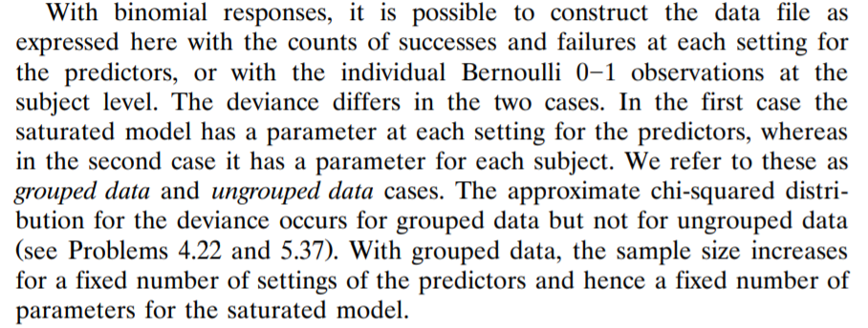
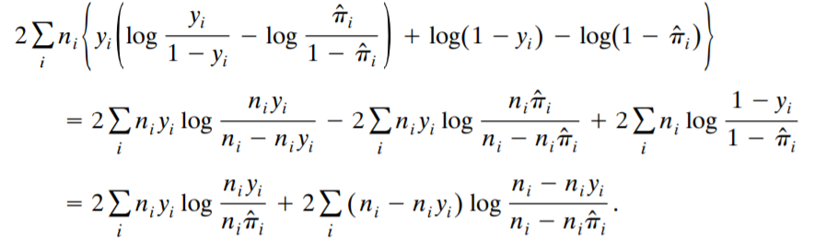

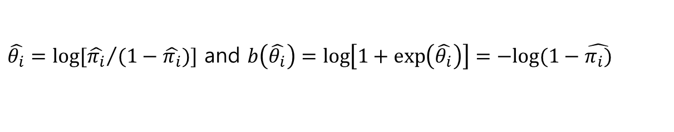

Example : Deviance for binomial GLMs
<$Deviance for binomial GLMs$>
Recall, for binomial GLMs
$\hat{θ_{i}}=log⁡[{\hat{π_{i}}}/{(1−\hat{π_{i}})}]$ and $b\left(\hat{θ_{i}}\right)=\log\left[1+\exp\left(\hat{θ_{i}}\right)\right]=−log⁡(1−\hat{π_{i})}$
$$a\left(φ\right)=1/n_{i}$$

Slide 36
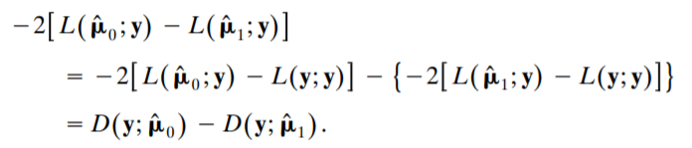



Likelihood-Ratio Model comparison
<$Likelihood−Ratio Model Comparison$>
$$L\left(y;y\right) is same$$
$$a\left(φ\right)=φ/w_{i}$$
Again deviance & approximately a chi-squared (df=diff parameter)
$$G^{2}(M_{0}|M_{1})$$

Slide 37
Likelihood-Ratio Model comparison
<$Likelihood−Ratio Model Comparison$>
$$L\left(y;y\right) is same$$
$$a\left(φ\right)=φ/w_{i}$$
Again deviance & approximately a chi-squared (df=diff parameter)
$$G^{2}(M_{0}|M_{1})$$

Slide 38

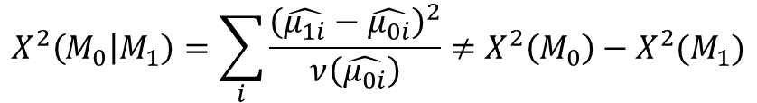
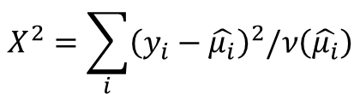
Score test for Model comparison
<$Score test Model Comparison$>
$Var\left(Y_{i}\right)=ν(μ_{i})$ with $φ=1$
$$X^{2}=\sum_{i}{{\left(y_{i}−\hat{μ_{i}}\right)}^{2}/ν\left(\hat{μ_{i}}\right)}$$
$$X^{2}\left(M_{0} | M_{1}\right)=\sum_{i}{\frac{{\left(\hat{μ_{1i}}−\hat{μ_{0i}}\right)}^{2}}{ν\left(\hat{μ_{0i}}\right)}}≠X^{2}\left(M_{0}\right)−X^{2}(M_{1})$$

